Slide 1
Aspergillomarasmine A treatment for the inhibition of metallo-beta-lactamase antibiotic resistance
Brendan Kearney
April 20, 2018

Slide 2
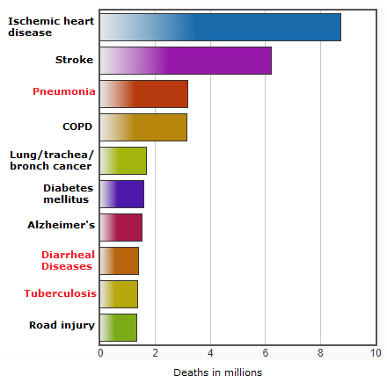
Bacteria are major causes of disease worldwide
Bacteria account for a large percentage of pathogens and illnesses affecting humans
According to the World Health Organization, people who are elderly, young, or have weakened immune response are more susceptible to pathogenic bacteria
Tuberculosis, malaria, E. coli are problematic in developing countries
Top causes of death globally in 2015
Source: WHO

Slide 3
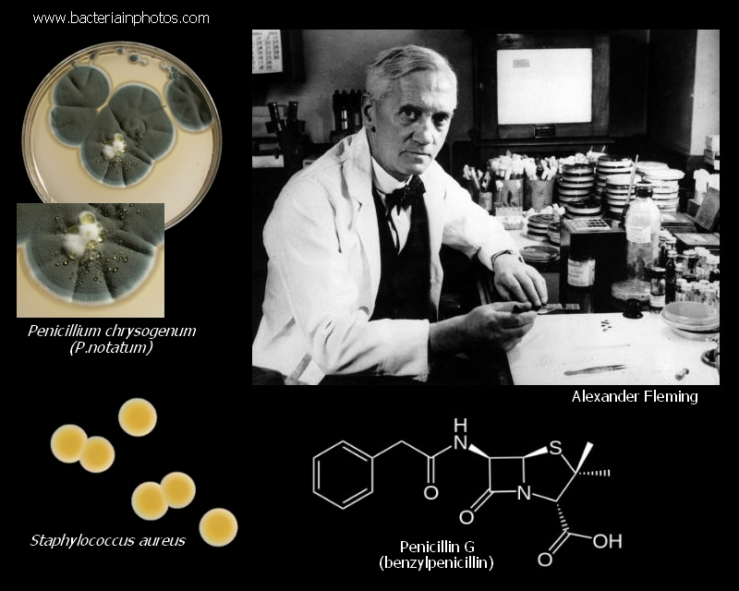
Antibiotics have revolutionized the treatment of pathogenic bacteria
Before early 20th century, lack of understanding led to inefficient treatment of disease (Aminov, Front Microbiol, 2010)
In 1928, penicillin was discovered in a bacteria-killing mold
Penicillin was easy to mass produce and cured a wide range of bacterial infections
Discovery of penicillin, 1928
Source: Bacteria in Photos

Slide 4
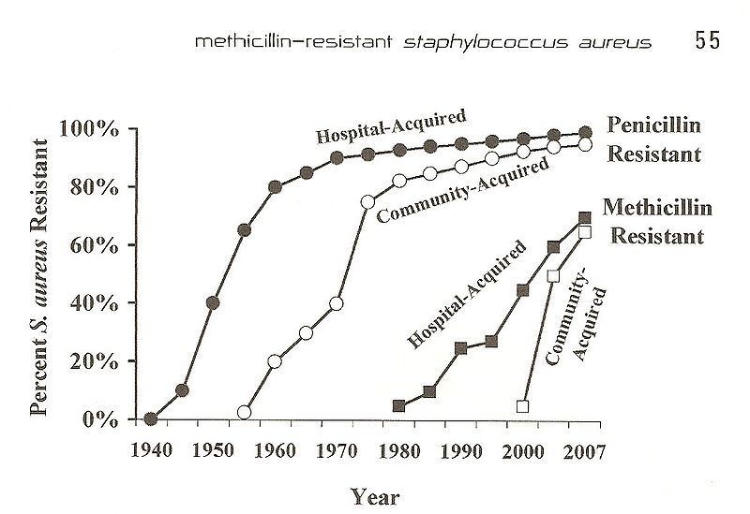
The problem with antibiotics
Bacterial populations are infinitely expandable and infinitely mutable (Hart, BMJ, 1998)
Surviving mutants may create new strain resistant to previously-effective antibiotics
Resistance can be passed to other species through horizontal gene transfer
Increase in MRSA antibiotic resistance over time
Source: McDonald 2006

Slide 5
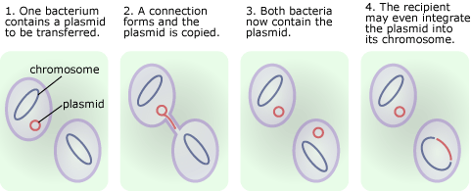
Horizontal gene transfer with plasmids
Source: Understanding Evolution

Slide 6
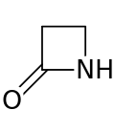
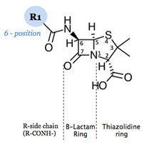
Beta-lactams are a common antibiotic
“Lactam” – a cyclic amide compound
The nitrogen atom occurs at the β position (2nd) relative to the C=O bond.
Account for 65% of total antibiotics market worldwide (Thakuria and Lahon, J Clin Diagn Res, 2013)
Beta-lactams like penicillin are the first choice for common bacterial infections
Core structure of beta-lactams
Penicillin
Source: EMB Consult

Slide 7
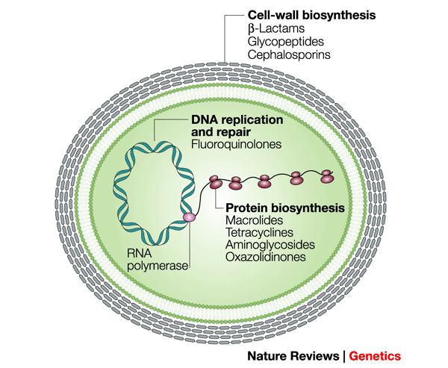
Beta-lactams inhibit bacterial cell wall synthesis
Bind to enzymes called penicillin-binding proteins (PBPs), responsible for cell wall building (Koch, Crit Rev Microbiol, 2000)
Causes malfunctional biosynthetic activity leading to depletion of energy
Source: Nature

Slide 8
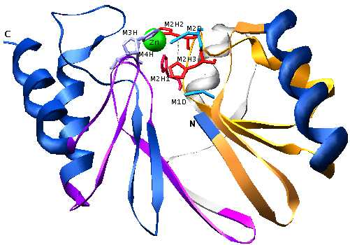
Beta-lactamases: bacteria’s defense for beta-lactams
Beta-lactamases – bacterial enzymes that offers resistance to beta-lactams
Divided into four classes
A
B
C
D
Core beta-lactamase fold
Source: In Silico Biology

Slide 9
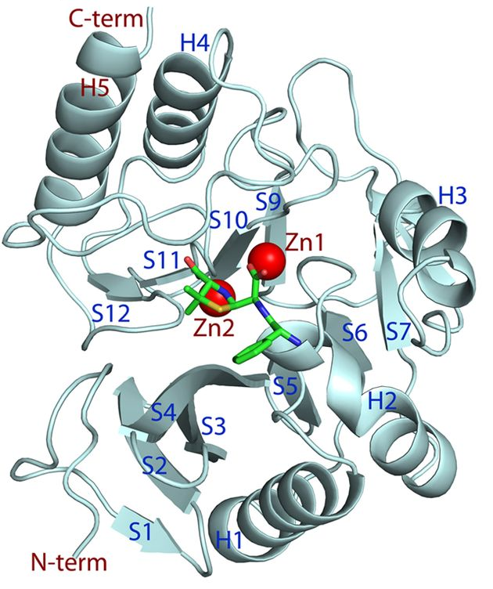
NDM-1, a new global infection
New Delhi metallo-beta-lactamase I (NDM-1) was identified in K. pneumoniae in 2008
Originated in the Indian subcontinent, but has since spread to over 40 countries
~40% mortality rate (Jamal, PLoS One, 2016)
No direct treatments are available currently (Spyrakis, ACS Med Chem Lett, 2018)
New Delhi metallo-beta-lactamase 1 structure
Source: Antimicrobial Agents and Chemotherapy

Slide 10
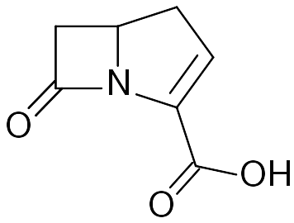
NDM-1 is a “superbug”
NDM-1
Class B, gram-negative
Strains containing NDM-1 exhibit strong multidrug resistance (Sun, PloS One, 2014)
Notable for being carbapenemases
Carbapenems are “last resort” drugs
Carbapenem
Source: In Silico genomics

Slide 11
Main topics
How does NDM-1 limit the effectiveness of beta-lactams?
What are possible modes of inhibition of NDM-1?
Can NDM-1 be inhibited by aspergillomarasmine A?

Slide 12
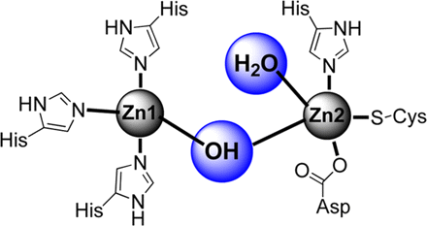
Structure of NDM-1
Contains two Zn²⁺ atoms at the active site
Zinc atoms are coordinated with water molecules and imidazole groups
Hydrophilic amino acid residues contribute to stability (Green, Acta Crystallogr Sect F Struct Biol Cryst Commun, 2011)
Active site of NDM-1
Source: (Faridoon and Islam, 2013)

Slide 13
NDM-1 disables beta-lactams
Hydroxyl group attacks beta-lactams (Fast, Biochim Biophys Acta, 2013)
Chelating ability of zinc allows hydroxyl to nucleophilic attack cyclic amide structure
Hydroxyl nucleophile of NDM-1
Source: (Faridoon and Islam, 2013)

Slide 14
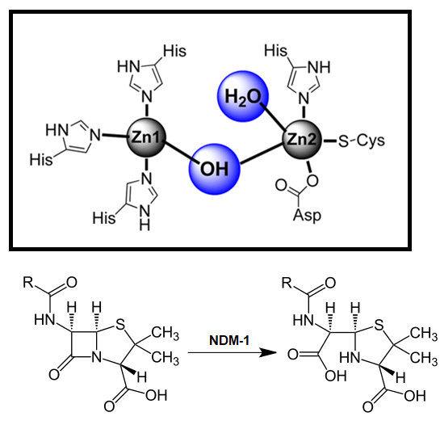
Mechanism of nucleophilic attack
The cyclic amide bond in beta-lactams is cleaved by NDM-1 hydrolysis (Spyrakis, ACS Med Chem Lett, 2018)
Bacteria’s defense mechanism against beta-lactams
Renders most antibiotics useless against bacteria
Deactivation of penicillin by NDM-1 beta-lactamase
Source: Antimicrobe

Slide 15
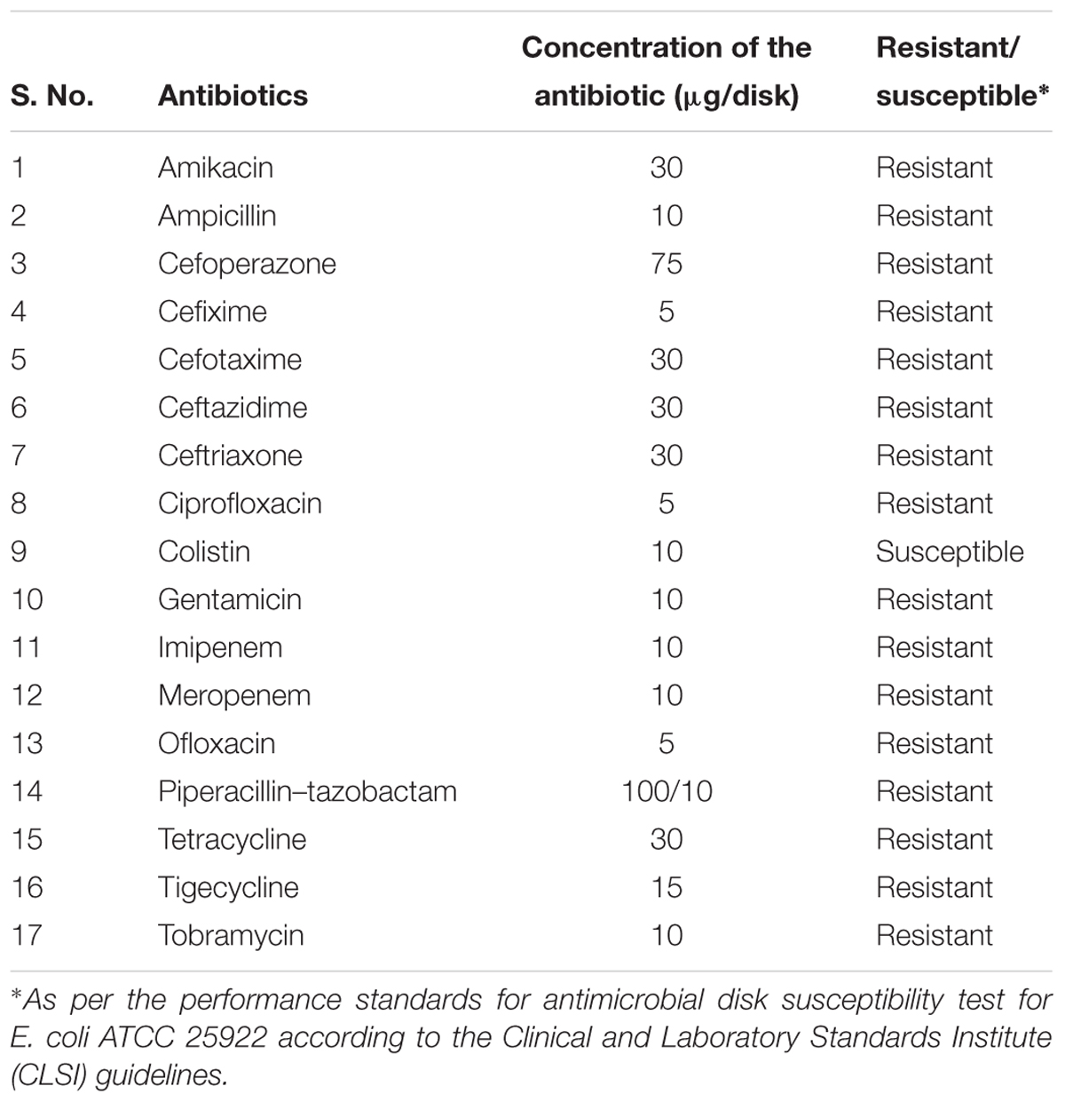
NDM-1 is multidrug resistant
Resistance/susceptibility of E. coli containing NDM-1 to common beta-lactam antibiotics
Source: Chandar et al. 2017

Slide 16
Main topics
How does NDM-1 limit the effectiveness of beta-lactams?
What are possible modes of inhibition of NDM-1?
Can NDM-1 be inhibited by aspergillomarasmine A?

Slide 17
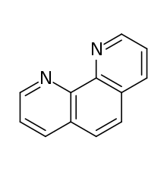
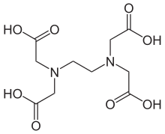
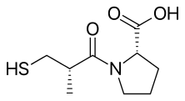
Many compounds have exhibited inhibition of bacterial NDM-1
Shared feature of NDM-1 inhibitors – removal of zinc atoms at the active site (Wang, Nat Commun, 2018)
Form strong coordination complexes through ligand binding
Captopril is a treatment for hypertension (Büttner, ACS Infect Dis, 2017)
Phenanthroline
EDTA
Captopril

Slide 18
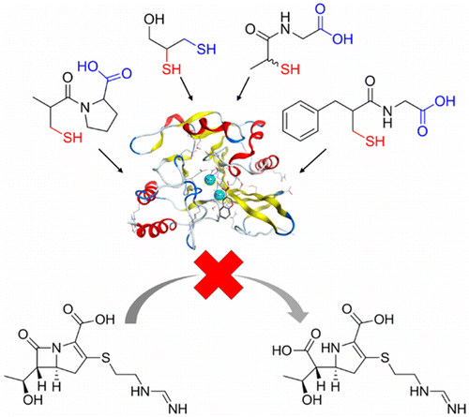
Zinc ions can be removed from the active site of NDM-1
Thiol groups (-SH) are known zinc chelators (Spyrakis, ACS Med Chem Lett, 2018)
Without zinc at the active site, no hydrolysis of beta-lactams occurs
Thiol groups can “mimic” and replace the hydroxide and perform a futile attack on beta-lactams
Thiol-based compounds exhibiting inhibition of NDM-1 (DL-Captopril, 2,3-Dimercaprol, Tiopronin, DL-Thiorphan
Source: Klingler et al. 2015

Slide 19
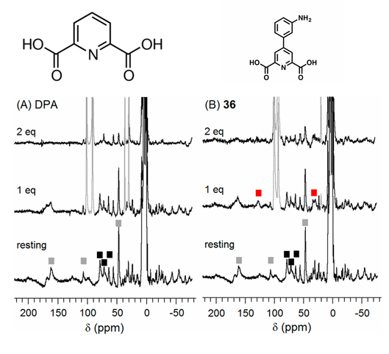
Dipicolinic acid as an alternative mode of inhibition
Derivatives of dipicolinic acid form a ternary NDM-1:Zn(II) inhibitor complex (Chen, J Med Chem, 2017)
Extremely potent and site-specific inhibition
Bypasses common issues
Inhibition of other Zn²⁺ dependent metalloenzymes
Can “kick” the water and bridge zinc ions together
Formation of ternary complex in derivative 36 (B) vs no formation in dipicolinic acid (A)
Source: Chen, J Med Chem, 2017

Slide 20
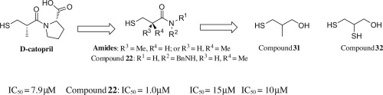
Why are there no treatments available?
No clinically-available drugs can inhibit NDM-1 without significant compositional changes (Li, Bioorg Med Chem Lett, 2014)
Issues to consider when choosing compounds
Selectivity
Effectiveness
Toxicity
Source: Li, Bioorg Med Chem Lett, 2014

Slide 21
Main topics
How does NDM-1 limit the effectiveness of beta-lactams?
What are possible modes of inhibition of NDM-1?
Can NDM-1 be inhibited by aspergillomarasmine A?

Slide 22
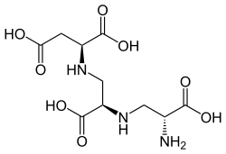
AMA - a natural fungal product
Aspergillomarasmine A (AMA) – derived from Aspergillus versicolor
Discovered in 1965
Known for its necrotic effects on leaves
Inhibitor of angiotensin-converting enzymes and endothelin-converting enzymes in blood hormonal control (Arai, Biosci Biotech Bioch, 1993)
Aspergillomarasmine A

Slide 23
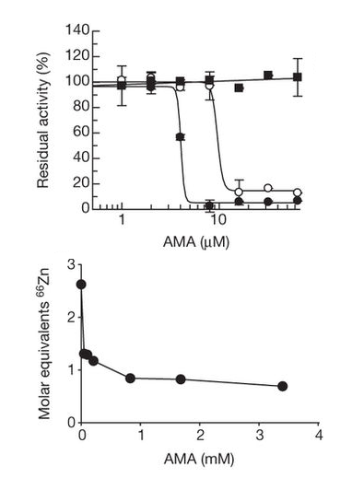
AMA inhibition of NDM-1
Samples of topsoil containing AMA showed inhibition of NDM-1 (King, Nature, 2014)
Suppression of 88% of 200 NDM-1 bacteria samples
Zinc atoms are inactivated or removed from the active site (Bergstrom, ACS Infect Dis, 2017)
Top: AMA reduces NDM-1 function (black circles)
Bottom: Zinc is depleted from NDM-1 following AMA treatment
Source: King, Nature, 2014

Slide 24
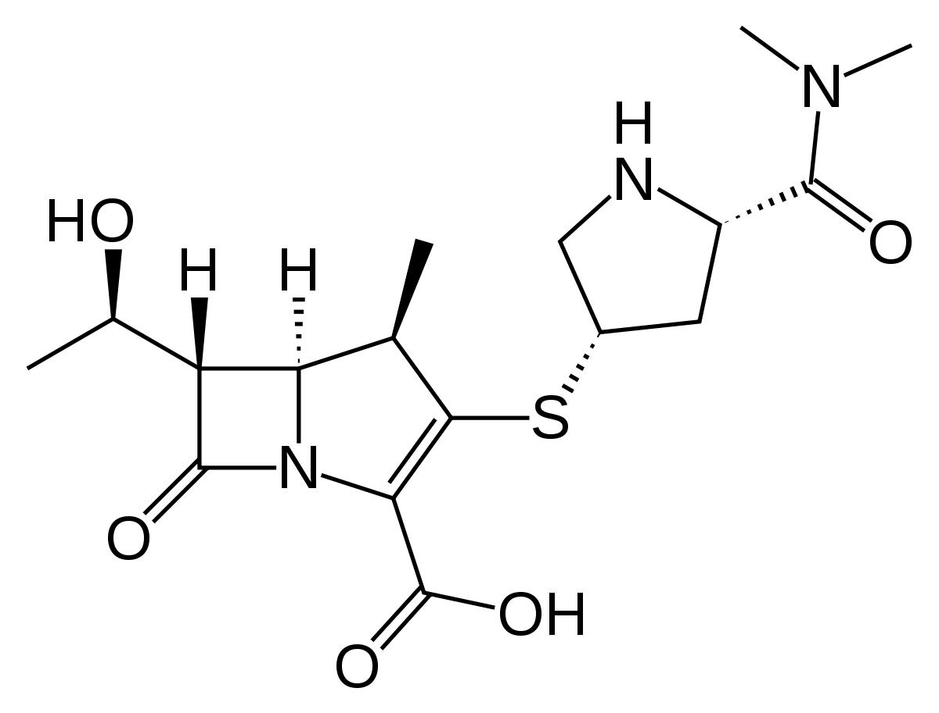
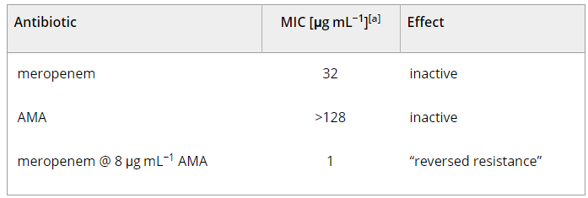
AMA - deadly in combination
NDM-1 completely inactivates meropenem
Addition of AMA reactivates meropenem activity and decreases NDM-1 bacteria concentration (Nussbaum, Angew Chem Int Ed Engl, 2014)
Top: Meropenem, a “last-resort” beta-lactam
Bottom: Minimal inhibitory concentration (MIC) of K. pneumoniae with uncombined/combined treatments
Source: Nussbaum, Angew Chem Int Ed Engl, 2014

Slide 25
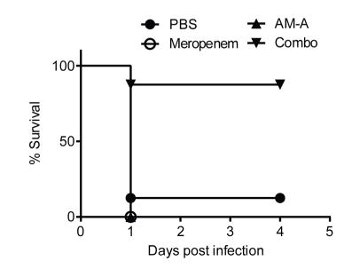
Comparison of AMA to other NDM-1 inhibitors
More specific than other chelators with similar zinc-removal mechanism
Strong inhibition levels
Can be purified in large quantities (King, Nature, 2014)
Not toxic in mice
Mouse survival after being infected with E. coli containing NDM-1 gene
Source: King, Nature, 2014

Slide 26

Conclusions
How does NDM-1 limit the effectiveness of beta-lactams?
The hydroxyl group of NDM-1, stabilized by zinc ions, nucleophilically attacks beta-lactams

Slide 27
Conclusions
What are possible modes of inhibition of NDM-1?
The removal of zinc ions by ligand-binding molecules

Slide 28
Conclusions
Can NDM-1 be inhibited by aspergillomarasmine A?
AMA is very specific in regards to NDM-1 inhibition
Easily available, nontoxic

Slide 29
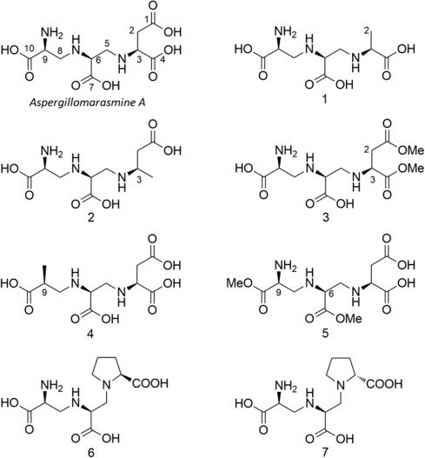
Future Direction of AMA inhibition research
Currently in preclinical stages
Decisions being studied:
Is the molecule actually safe for humans?
Which derivative should be manufactured?
Will enzyme assays and mice studies convey to treatment for humans?
AMA and synthesized derivatives
Source: Zhang, Bioorg Med Chem, 2017

Slide 30
Credits
Aminov RI. A Brief History of the Antibiotic Era: Lessons Learned and Challenges for the Future. Front Microbiol. 2010;1:134
Hart CA. Antibiotic resistance: an increasing problem? BMJ. 1998;316(7140):1255–1256.
Thakuria B, Lahon K. The Beta Lactam Antibiotics as an Empirical Therapy in a Developing Country: An Update on Their Current Status and Recommendations to Counter the Resistance against Them. J Clin Diagn Res. 2013;7(6):1207-1214.
Koch AL. Penicillin binding proteins, beta-lactams, and lactamases: offensives, attacks and defensive countermeasures. Crit Rev Microbiol. 2000;26(4):205-220.
Spyrakis F, Celenza G, Marcoccia F, Santucci M, Cross S, Bellio P, Cendron L, Perilli M, Tondi D. Structure-Based Virtual Screening for the Discovery of Novel Inhibitors of New Delhi Metallo-β-lactamase-1. ACS Med Chem Lett. 2018;9(1):45-50.
Sun Y, Liu Q, Chen S, Song Y, Liu J, Guo X, Zhu L, Ji X, Zhou W et al. Characterization and Plasmid Elimination of NDM-1-Producing Acinetobacter calcoaceticus from China. PloS One. 2014;9(9):e106555.
Green VL, Verma A, Owens RJ, Phillips SEV, Carr SB. Structure of New Delhi metallo-β-lactamase 1 (NDM-1). Acta Crystallogr Sect F Struct Biol Cryst Commun. 2011;67(Pt10):1160-1164.
Büttner D, Kramer JS, Klingler F-M, Wittmann SK, Hartmann MR, Kurz CG, Kohnhäuser D, Weizel L, Brüggerhoff A, Frank D, et al. Challenges in the Development of a Thiol-Based Broad-Spectrum Inhibitor for Metallo-β-Lactamases. ACS Infect Dis. 2017;4(3):360–372.

Slide 31
Credits
Li NN, Xu YT, Xia Q, Bai CG, Wang TY, Wang L, He DD, Xie NN, Li LX, Wang J, Zhou HG, et al. Simplified captopril analogues as NDM-1 inhibitors. Bioorg Med Chem Lett. 2014;24(1):386-389.
Wang R, Lai TP, Gao P, Zhang HM, Ho PK, Woo PCY, Ma GX, Kao RYT, Li HY, Sun HZ. Bismuth antimicrobial drugs serve as broad-spectrum metallo-β-lactamase inhibitors. Nat Commun. 2018;9:439.
Chen AY, Thomas PW, Stewart AC, Bergstrom A, Cheng Z, Miller C, Bethel CR, Marshall SH, Credille CV, Riley CL. Dipicolinic Acid Derivatives as Inhibitors of New Delhi Metallo-β-lactamase-1. J Med Chem. 2017;60(17):7267-7283.
Arai K, Ashikawa N, Nakakita Y, Matsuura A, Ashizawa N, Munekata M. Aspergillomarasmine A and B, Potent Microbial Inhibitors of Endothelin-converting Enzyme. Biosci Biotech Bioch. 1993;57(11):1944-1945.
King AM, Redi-Yu SA, Wang WL, King DT, De Pascale G, Strynadka NC, Walsh TR, Coombes BK, Wright GD. AMA overcomes antibiotic resistance by NDM and VIM metallo-β-lactamases. Nature. 2014;510(7506):503-506.
Von Nussbaum F, Schiffer G. Aspergillomarasmine A, an Inhibitor of Bacterial Metallo‐β‐Lactamases Conferring blaNDM and blaVIM Resistance. Ang Chem Int. 2014;53(44)
Zhang J, Wang S, Wei Q, Guo Q, Bai Y, Song F, Zhang L, Lei X. Synthesis and biological evaluation of Aspergillomarasmine A derivatives as novel NDM-1 inhibitor to overcome antibiotics resistance. Bioorg Med Chem. 2017;25(10):5133-5141.

Slide 32
Image Sources
http://www.who.int/mediacentre/factsheets/fs310/en/
http://www.bacteriainphotos.com/Alexander_Fleming_and_penicillin.html
https://microbewiki.kenyon.edu/index.php/Antibiotic_Resistance_Within_Staphylococcus_Aureus
https://evolution.berkeley.edu/evolibrary/search/imagedetail.php?id=360&topic_id=&keywords=
https://www.ebmconsult.com/articles/penicillin-allergy-cross-reactivity-cephalosporin-antibiotics
nrg/journal/v4/n6/box/nrg1086_BX1.html
http://www.bioinfo.de/isb/1998/01/0008/
http://aac.asm.org/content/56/10/5157/F2.expansion.html
http://www.antimicrobe.org/hisphoto/history/NDM-1_Mietzner_Dec2013.asp
https://pubs.acs.org/doi/full/10.1021/jm501844d?src=recsys
https://www.sciencedirect.com/science/article/pii/S0960894X13012742?via%3Dihub

